Slide 1
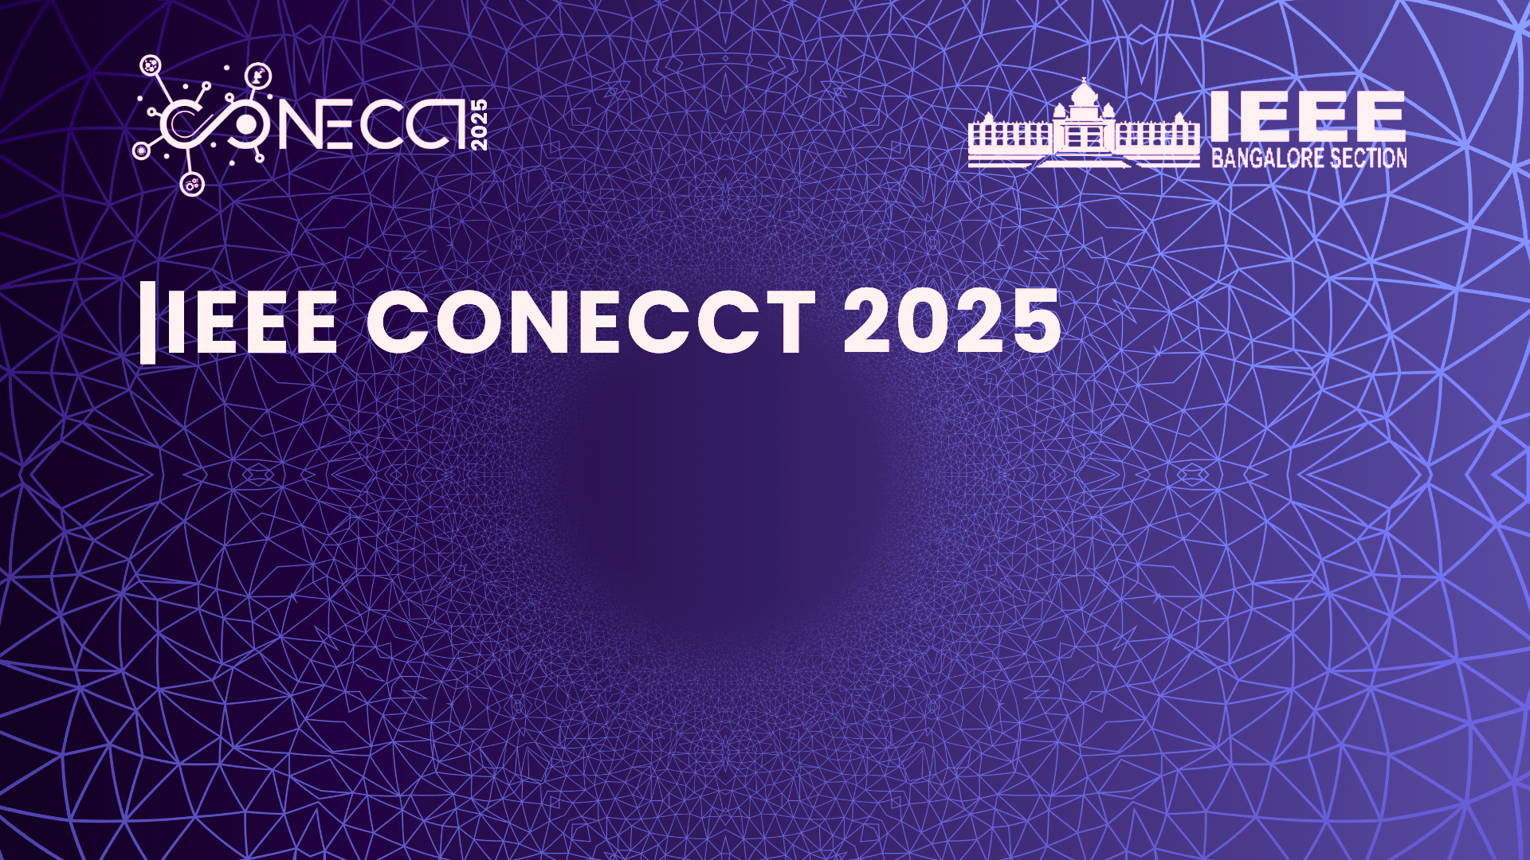


GaitSens: AI-Powered Gait and Mobility Analysis
An academic-industry collaborative research between SRM & SAMSUNG PRISM
Paper ID and Track: 1492, Advances in Healthcare Technologies
Harshita, Vaishnavi Moorthy: Dept. of Networking and Communications, SRMIST
Pushpalatha M: Dept. of Computing Technologies, SRMIST
Suresh J: College of Physiotherapy, SRMIST
Shilpa Onkar Singh, Sumit Kumar: Samsung Research And Development

Slide 2


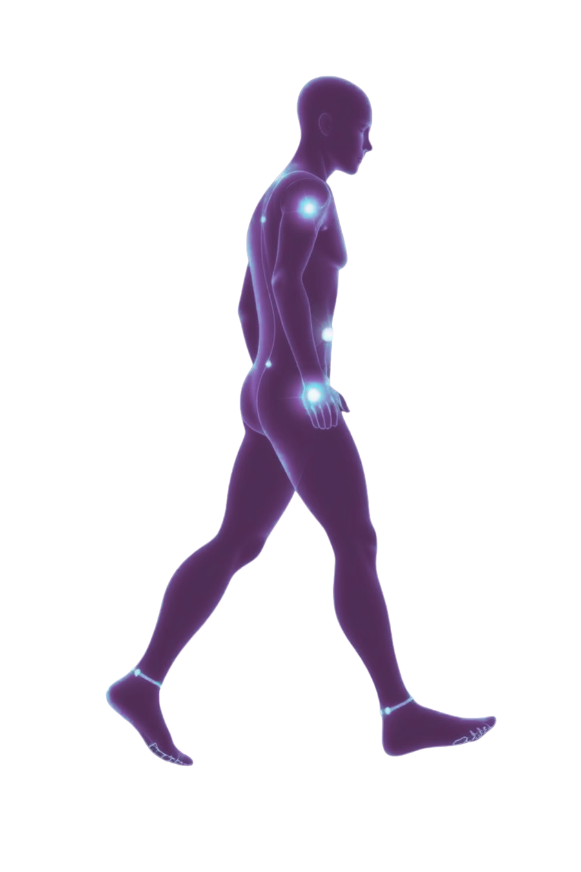


INTRODUCTION
Falls are one of the leading causes of injury and hospitalization, particularly in older adults. Traditional ways to analyze gait (like lab motion-capture systems or wearable suits) are expensive and not portable.
GaitSens proposes a cost-effective, straightforward, and portable system utilizing only smartphones and machine learning, making gait analysis accessible for daily use at home.

Slide 3

NOVELTY
Portable
OS-Independent
Works Offline
Putting smart fall risk detection right into your hands.

Slide 4

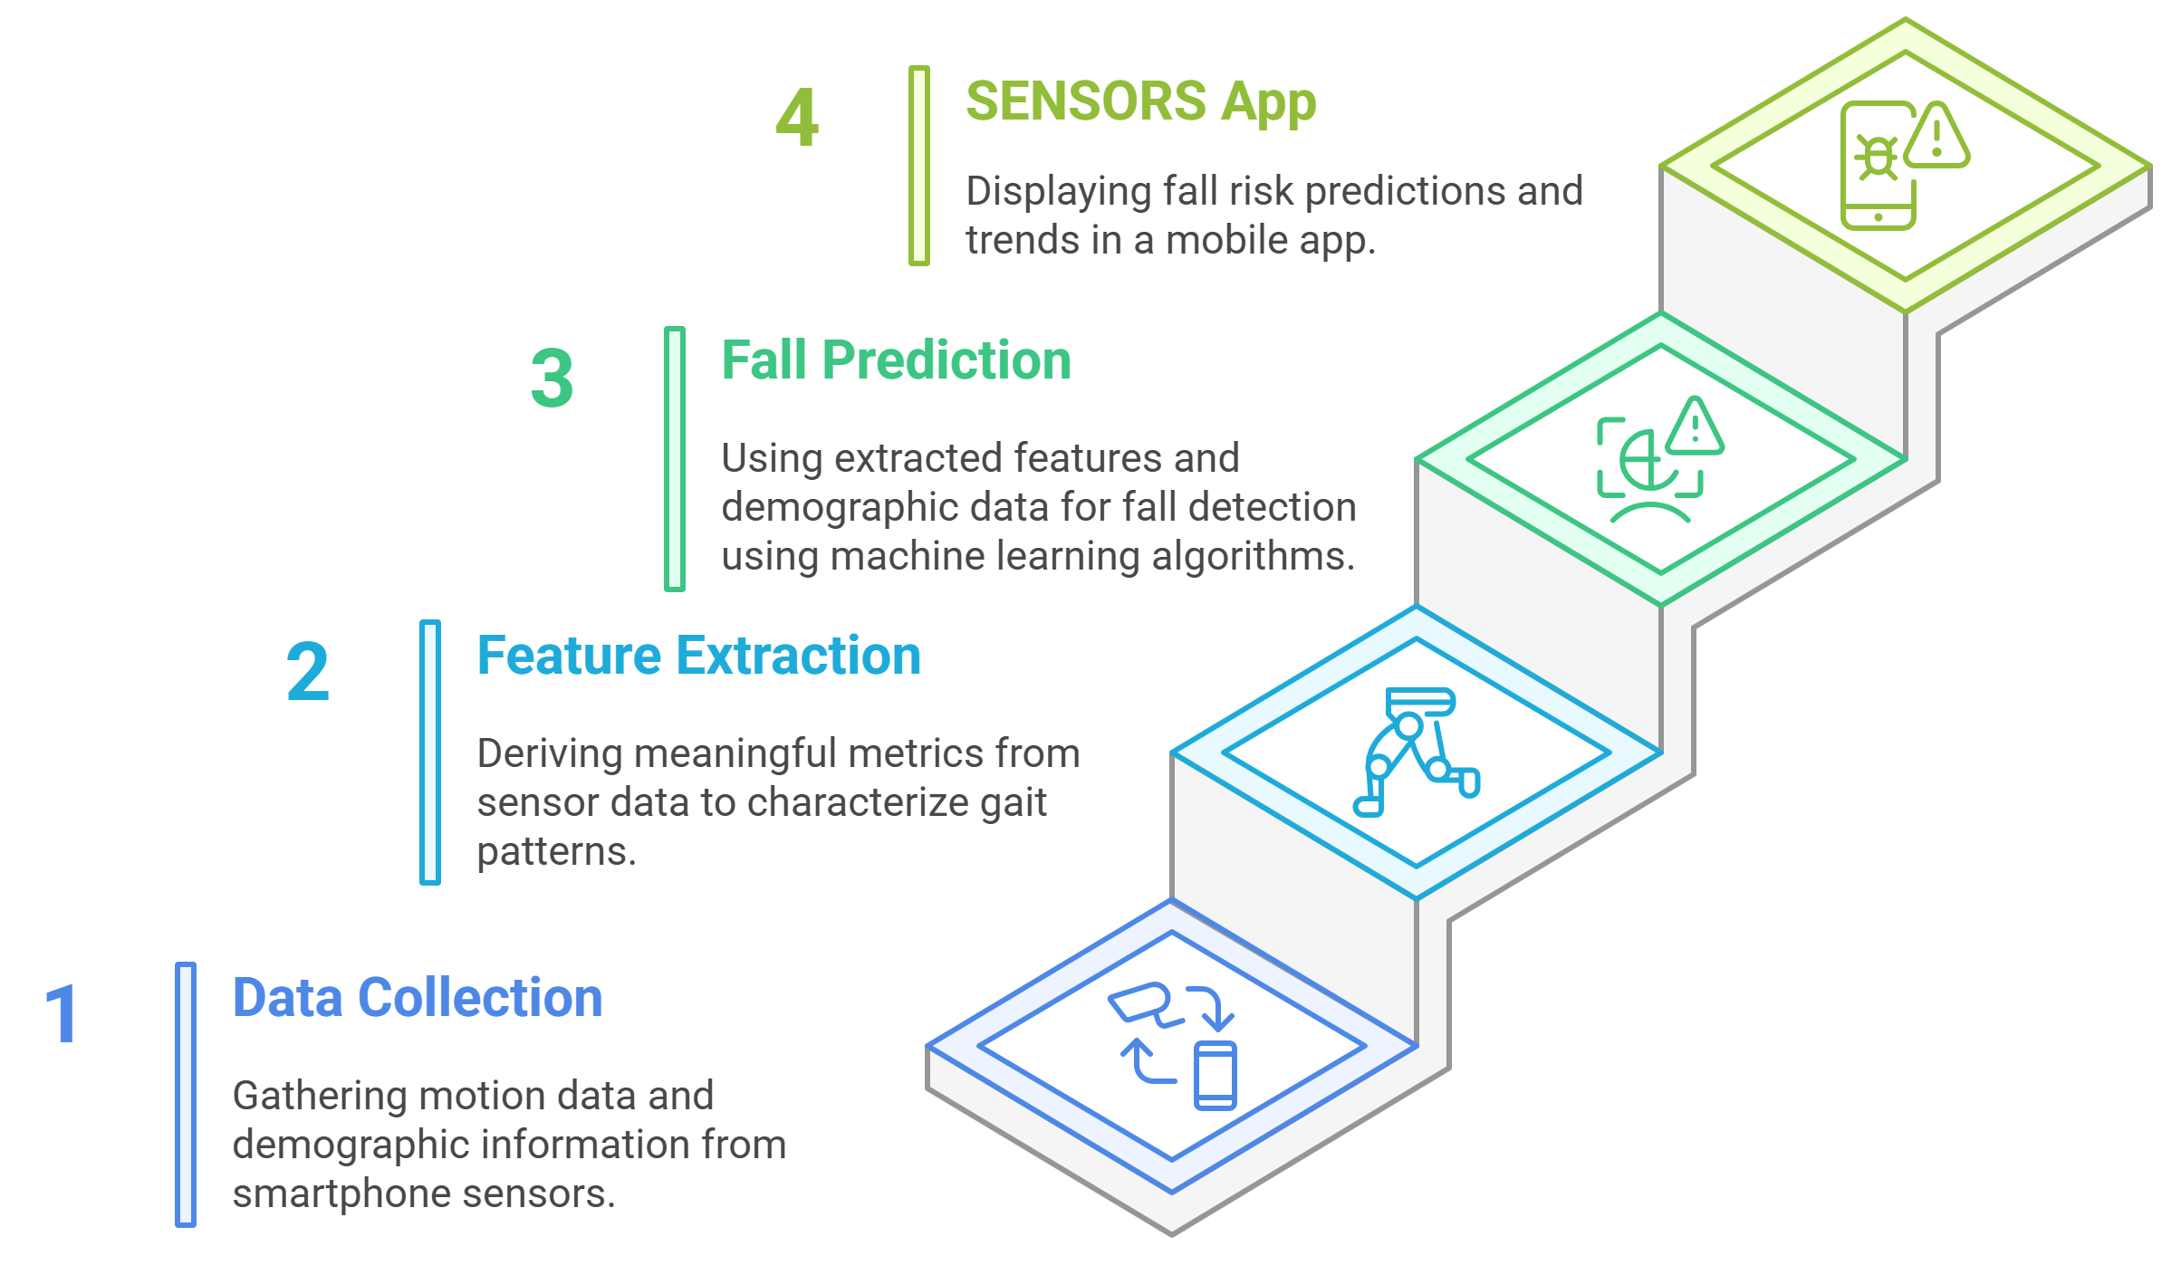



PIPELINE
SENSORS

Slide 5

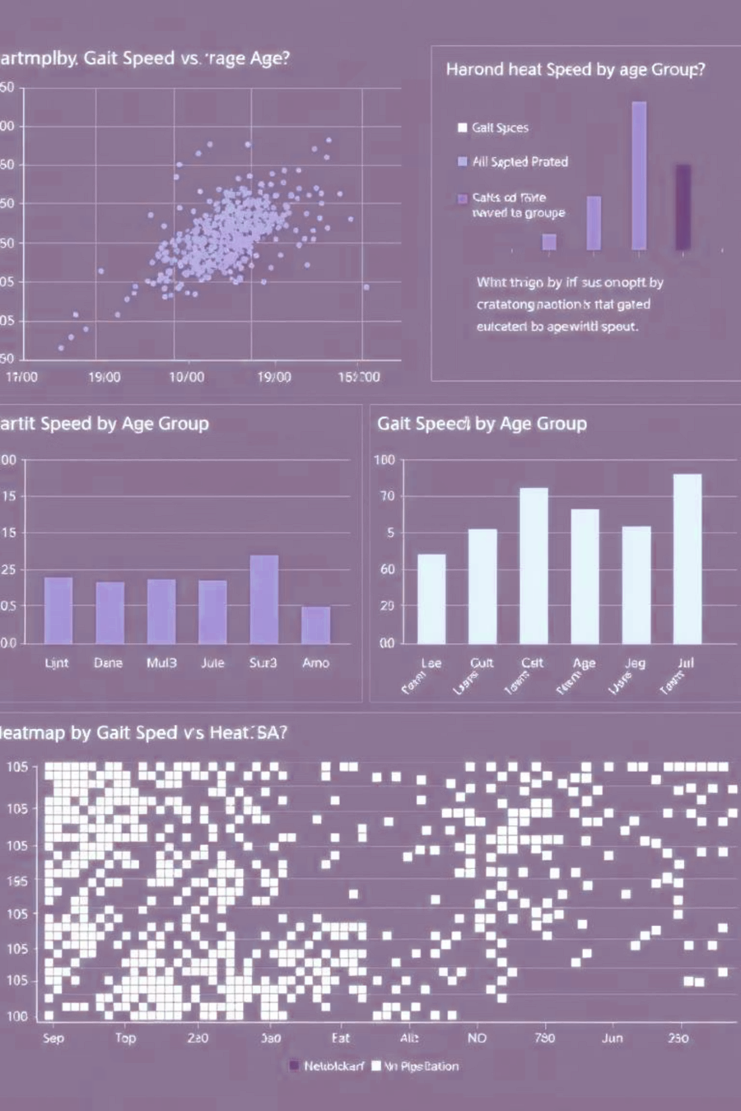
Application
The "Sensors" application offers real-time fall risk prediction using smartphone sensors. It features an architecture for on-device processing and advanced machine learning-based fall prediction. The dataset encompasses a diverse array of health conditions collected through medical trials that exert significant influence on individuals’ mobility and gait patterns
The model analyzes:
acceleration readings
stride length
cadence
gyroscope readings
It uses techniques like train-test splits, feature scaling, and regularization to prevent overfitting. Thus, providing medically validated results.

Slide 6

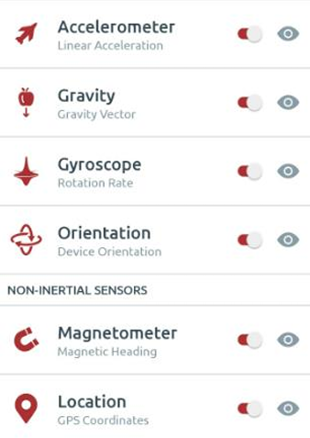
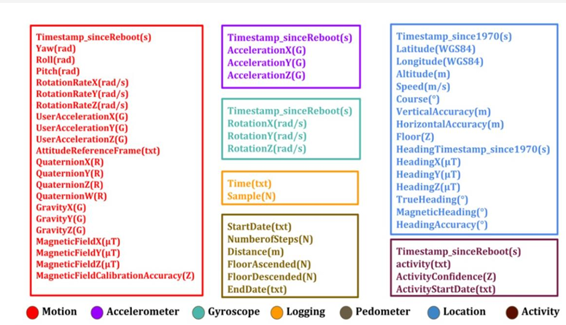
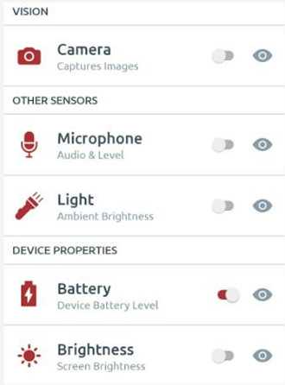
DATASET COLLECTION
The following details were calculated through user input:
Gait Speed
Step Length
Stride Length
Cadence
The following details were extracted straight from the sensor logger app:
Accelerometer
Gravity
Gyroscope
Duration
The following details were user input:
Age
Gender
Activity
Height
Weight
Fig 2 : Different Sensor Data being collected using smartphone.

Slide 7
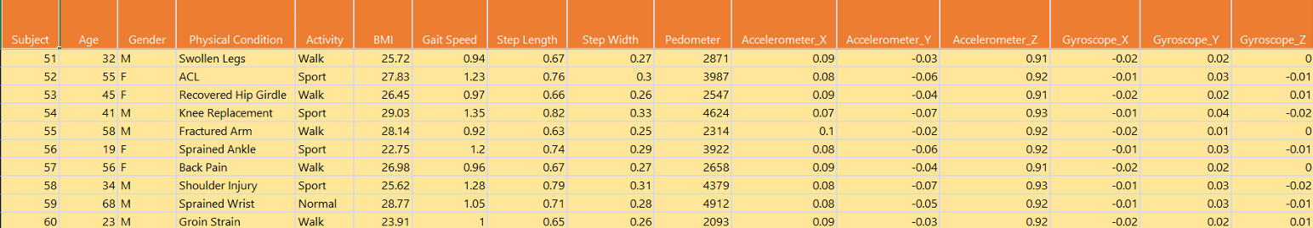
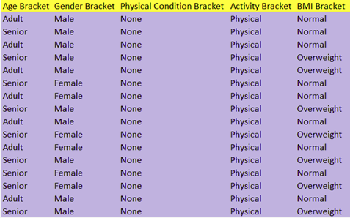
DATASET PREPARATION
The following dataset was acquired from healthy people over a wide array of ages with some physical conditions.
Table 1: Final Dataset Prepared
The following conditions were considered:
Swollen Legs
ACL
Recovery from surgery
Sprained Ankle
Recovered Hip Girdle
Obesity
Knee Replacement
Table 2: Activity Dataset

Slide 8
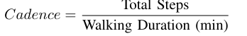
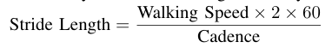
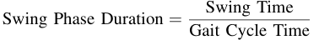
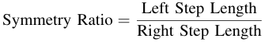
MODEL EVALUATION
Using a gradient-boosted decision tree model, to predict fall risk from gait features.
Because:
A gradient boosted decision tree model handles non-linearity effortlessly.
Works with mixed features : Categorical & Numeric.
Deals with missing values, outliers, scaling automatically.
Synthetic data augmentation expanded samples, reducing overfitting and improving generalization

Slide 9
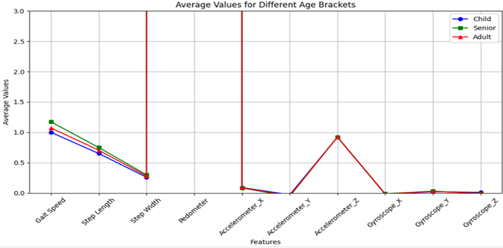
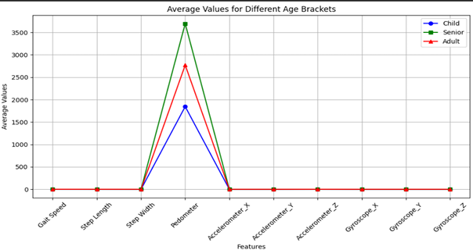
MODEL TRAINING
Fig 3:
ML pipeline ensures balanced learning and realistic performance:
Train-Test Split
Model Initialization
Feature Scaling
Fig 4:
Performance Metrics:
Evaluated using Accuracy ~ 86%
Precision ~ 93%
Recall ~ 92%
F1 Score ~ 92%

Slide 10

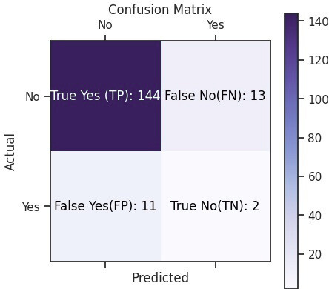
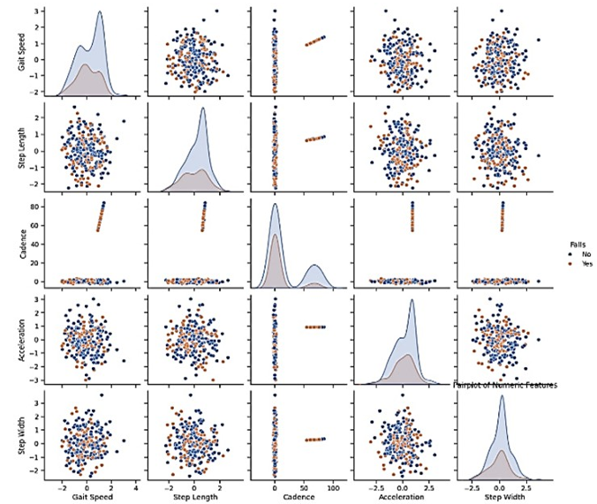
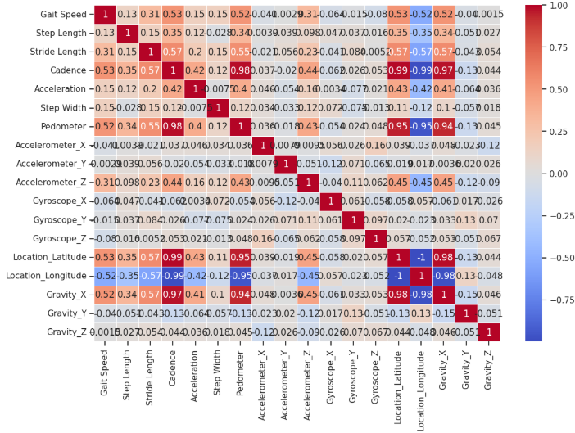
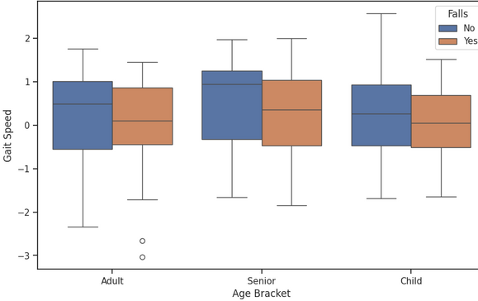
MODEL PERFORMANCE AND VALIDATION
5-Fold Cross-Validation: Ensures stability & reduces overfitting risk by validating across multiple data splits.
Regularization & Early Stopping: L1 & L2 regularization plus stopping after 10 rounds without improvement to avoid overfitting.
All results are clinically APPROVED.
The model's performance is evaluated
Fig 5:
Fig 6: Pattern detection between falls and no falls conditions
Fig 7: Correlation Heatmap
Fig 8 : Box Plot Analysis of Gait Speed by Age Bracket

Slide 11

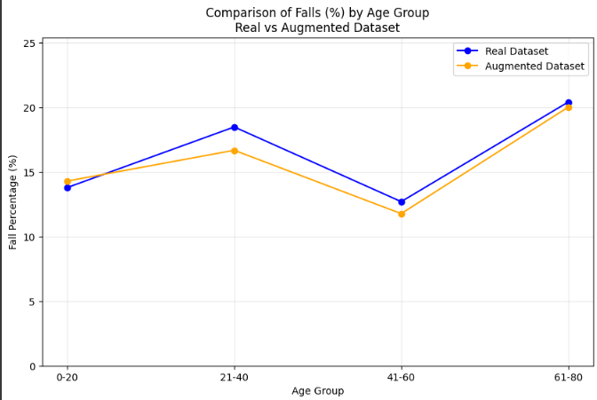
MODEL PERFORMANCE AND VALIDATION
Visual & Medical data analysis
Augmented dataset closely mirrors real-world fall validating its reliability for training.
Missing data is managed by built-in handling of nulls, complemented by pre-cleaning and synthetic augmentation to maintain data integrity.
Fig 9 : Real vs Augmented Dataset Fall Comparison

Slide 12
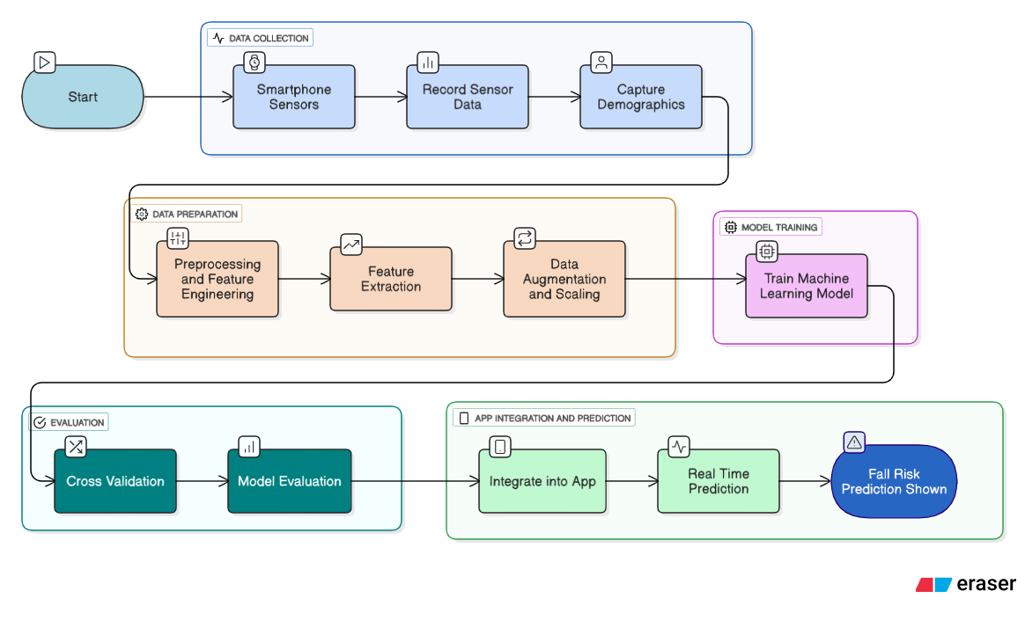
APPLICATION FLOW
Fig 1: Application Flow

Slide 13
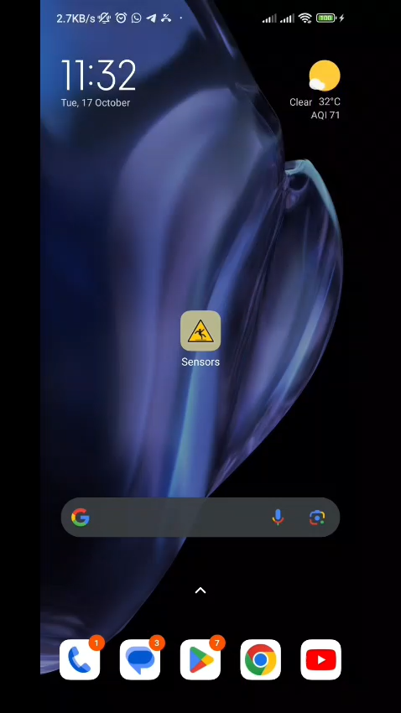

SENSORS:
SENSORS

Slide 14

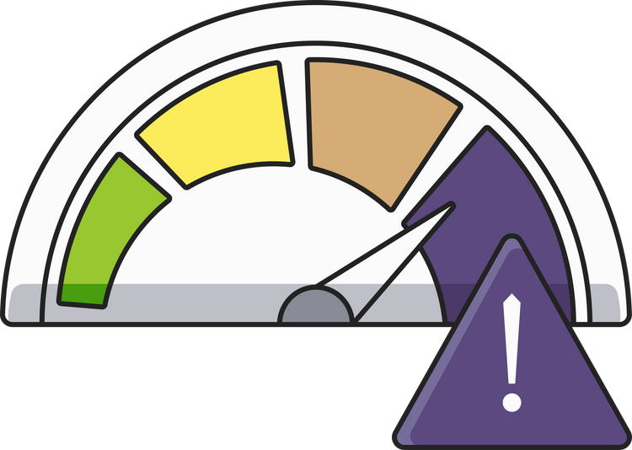
FURTHER ADVANCEMENTS
Larger and more varied datasets.
Physiological and behavioral data
Detailed analysis of walking speed
Constant Medical Support
Leveraging supplementary data sources like video analysis and smartwatch data, along with advancements in wearable technology, will further improve gait analysis and fall detection systems.
SENSORS

Slide 15

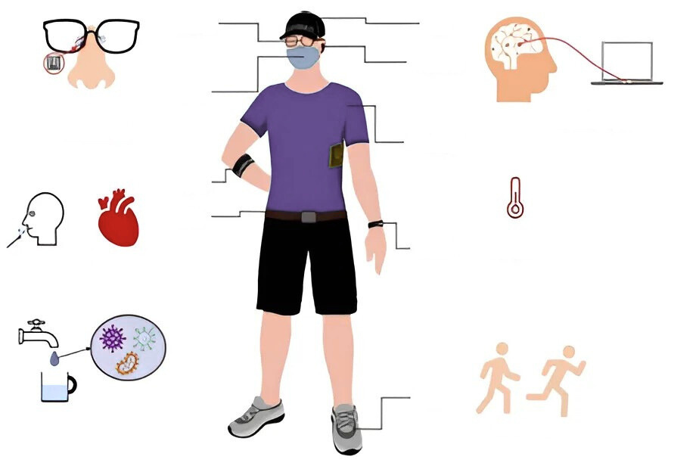
FUTURE PROSPECTS
Glasses
Hat
Multi-Model Sensing
Location and Activity Tracking
Auto-adaptive ML models
Age and Gender-Specific
Personalized Interventions
Headset
Mask
Swoit electrolytes
Electroencephalography
and metabolites
Clothing
Strip
Belt
Watch
Body
Tampereuro
Saliva
Hourt rate
Shoes
Walk Pace
Fig 10 : Multiple Body Sensors

Slide 16

REFERENCES
[1] Khlood Ahmad, Mohamed Abdelrazek, Chetan Arora, Muneera Bano, and John Grundy. Requirements engineering for artificial intelligence systems: A systematic mapping study, 12 2022.
[2] Neil B Alexander and A Goldberg. Clinical gait and stepping perfor mance measures in older adults. European Review of Aging and Physical Activity, 3:20–28, 2006.
[3] Clare C. Bassile and Sheila M. Hayes. Chapter 9- gait awareness. In Glen Gillen, editor, Stroke Rehabilitation (Fourth Edition), pages 194 223. Mosby, fourth edition edition, 2016.
[4] Eduardo Casilari, Jos´ e-Antonio Santoyo-Ram´on, and Jos´e-Manuel Cano Garc´ ıa. Analysis of public datasets for wearable fall detection systems. Sensors, 17(7):1513, 2017.
[5] Luis Enrique D´ ıez, Alfonso Bahillo, Jon Otegui, and Timothy Otim. Step length estimation methods based on inertial sensors: A review. IEEE Sensors Journal, 18(17):6908–6926, 2018.
[6] Abhishesh Homagain and Kaylena A Ehgoetz Martens. Emotional states affect steady state walking performance. PLoS One, 18(9):e0284308, 2023.
[7] Babar A Khan, Anthony J Perkins, Noll L Campbell, Sujuan Gao, Mark O Farber, Sophia Wang, Sikandar H Khan, Ben L Zarzaur, and Malaz A Boustani. Pharmacological management of delirium in the intensive care unit: a randomized pragmatic clinical trial. Journal of the American Geriatrics Society, 67(5):1057–1065, 2019.
[8] Bonghyun Kim. Implementation of falling accident monitoring and prediction system using real-time integrated sensing data. KSII Transactions on Internet & Information Systems, 17(11), 2023.
[9] E. Pedersen, R. Primicerio, K. H. Halvorsen, A. E. Eggen, B. H. Garcia, H. Schirmer, and M. Waaseth. Medication adherence among persons with coronary heart disease and associations with blood pressure and low-density-lipoprotein-cholesterol. European Journal of Clinical Pharmacology, 78(5):857–867, May 2022.
[10] Ryota Sakurai, Robert Bartha, and Manuel Montero-Odasso. Entorhinal cortex volume is associated with dual-task gait cost among older adults with mci: results from the gait and brain study. The Journals of Gerontology: Series A, 74(5):698–704, 2019.

Slide 17
Thank You
SENSORS

